Slide 1
Indexes

Slide 2
Primary Indexes
Dense Indexes
Key-pointer pairs for every record (ordered by search key).
Can make sense because records may be much bigger than key­pointer pairs.
  Fit index in memory, even if data file does not?
  Faster search through index than data file?
Sparse Indexes
Key­pointer pairs for only a subset of records, typically first in each block.
Saves index space.

Slide 3
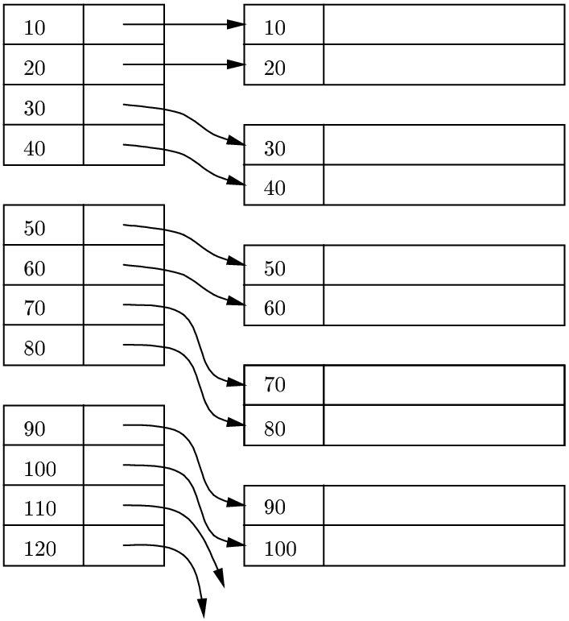
Dense Index

Slide 4
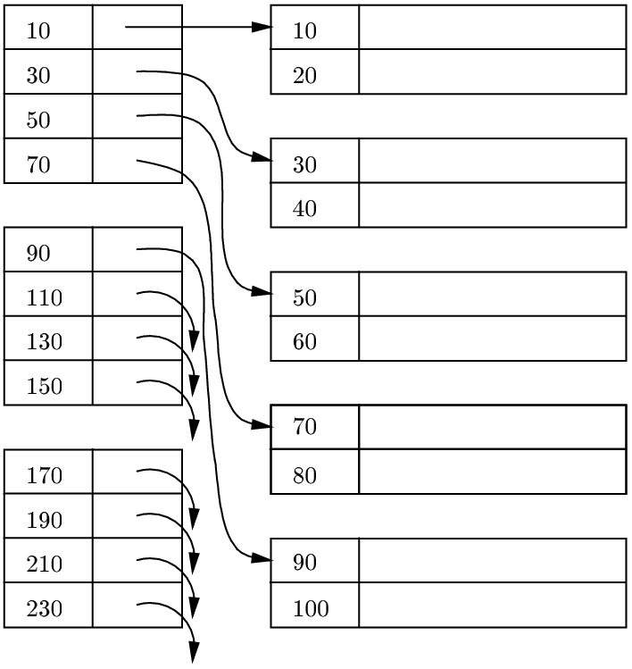
Sparse Index

Slide 5
Num. Example of Dense Index
Data file = 1,000,000 tuples that fit 10 at a time into a block of 4096 bytes (4KB)
100,000 blocks ➔ data file = 400 MB
Index file: For typical values of key 30 Bytes, and pointer 8 Bytes, we can fit: 4096/(30+8) ≈ 100 (key,pointer) pairs in a block.
So, we need 10,000 blocks = 40 MB for the index file. This might well fit into available main memory.

Slide 6
Num. Example of Sparse Index
Data file and block sizes as before
One (key,pointer) record for the first record of every block ➔
index file = 100,000 (key, pointer) pairs
= 100,000 * 38Bytes
= 1,000 blocks
= 4MB
If the index file could fit in main memory
➔ 1 disk I/O to find record given the key

Slide 7
Lookup for key K
Dense vs. Sparse:
Dense index can answer:
”Is there a record with key K?”
Sparse index cannot!
Lookup:
Find key K in dense index.
Find largest key ≤ K in sparse index.
Follow pointer.
a) Dense: just follow.
b) Sparse: follow to block, examine block.

Slide 8
Cost of Lookup
We can do binary search.
log₂ (number of index blocks) I/O’s to find the desired record.
All binary searches to the index will start at the block in the middle, then at 1/4 and 3/4 points, 1/8, 3/8, 5/8, 7/8.
  So, if we store some of these blocks in main memory, I/O’s will be significantly lower.
For our example: Binary search in the index may use at most log 10,000 = 14 blocks (or I/O’s) to find the record, given the key, … or much less if we store some of the index blocks as above.

Slide 9
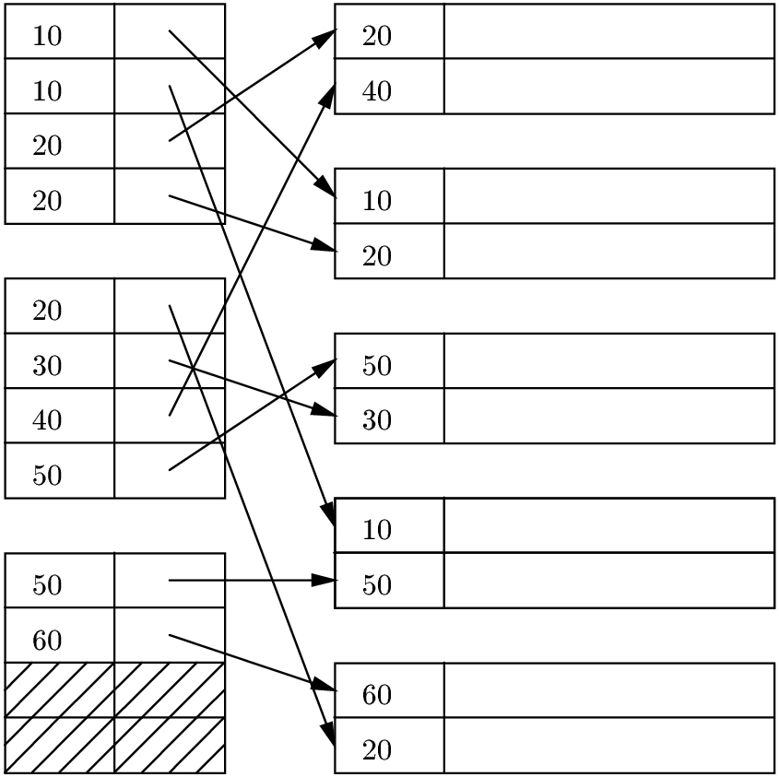
Secondary Indexes
A primary index is an index on a sorted file.
  Such an index "controls" the placement of records to be "primary,"
A secondary index is an index that does not "control placement."
Note. Sparse, secondary index makes no sense.

Slide 10
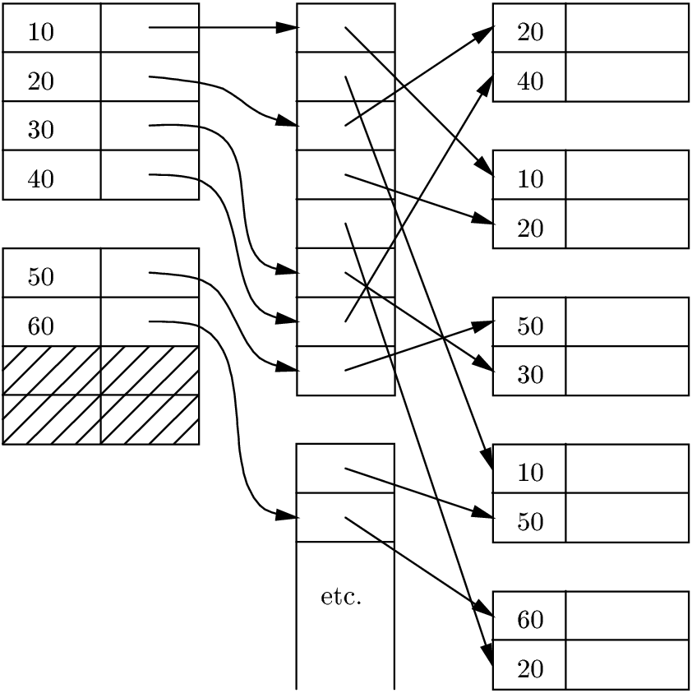
Indirect Buckets
To avoid repeating keys in index, use a level of indirection, called buckets.

Slide 11
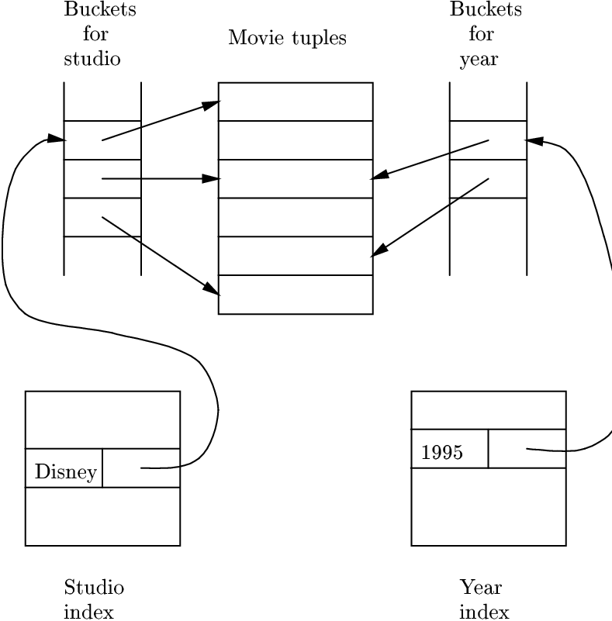
Pointer Intersection
Example
Movies(
title,
year,
length,
studioName);
Assume secondary indexes on studioName and year.
  SELECT title
  FROM Movies
  WHERE studioName='Disney' AND year = 1995;

Slide 12
Operations with Indexes
Deletions and insertions are problematic for flat indexes.
Eventually, we need to reorganize entries and records.

Slide 13
B­Trees: A typical leaf and interior node (unclustered index)
Leaf
57
81
95
To next leaf in
sequence
To record
with key 57
To record
with key 81
To record
with key 95
Interior Node
57
81
95
57, 81, and 95 are the least keys we can reach by via the corresponding pointers.
To subtree
with keys
K<57
To subtree
with keys
81≤K<95
To subtree
with keys
K≥95
To subtree
with keys
57≤K<81

Slide 14
A typical leaf and interior node (clustered index)
Leaf
57
81
95
To next leaf in
sequence
Record
with key 57
Record
with key 81
Record
with key 95
Interior Node
57
81
95
57, 81, and 95 are the least keys we can reach by via the corresponding pointers.
To keys
K<57
To keys
81≤K<95
To keys
K≥95
To keys
57≤K<81

Slide 15
Operations in B-Tree
Will illustrate with unclustered case, but straightforward to generalize for the clustered case.
Operations
Lookup
Insertion
Deletion

Slide 16
Lookup
13
Try to find a record with search key 41.
7
23 | 31 | 43
2 | 3 | 5
7 | 11
13 | 17 | 19
23 | 29
31 | 37 | 41
43 | 47
Recursive procedure:
If we are at an internal node with keys K₁,K₂,…,K_{n}, then if K<K₁we follow the first pointer, if K₁≤K<K₂ we follow the second pointer, and so on.
If we are at a leaf, look among the keys there. If the i-th key is K, the the i-th pointer will take us to the desired record.

Slide 17
Insertion
Try to insert a search key = 40.
First, lookup for it, in order to find where to insert.
13
7
23 | 31 | 43
2 | 3 | 5
7 | 11
13 | 17 | 19
23 | 29
31 | 37 | 41
43 | 47
It has to go here, but the node is full!
Notes:
Chapter 1
COMP 451/651

Slide 18
Beginning of the insertion of key 40
13
7
23 | 31 | 43
2 | 3 | 5
7 | 11
13 | 17 | 19
23 | 29
43 | 47
31 | 37
40 | 41
What’s the problem?
No parent yet for the new node!
Observe the new node and the redistribution of keys and pointers
Notes:
Chapter 1
COMP 451/651

Slide 19
Continuing of the Insertion of key 40
We must now insert a pointer to the new leaf into this node. We must also associate with this pointer the key 40, which is the least key reachable through the new leaf.
But the node is full. Thus it too must split!
13
7
23 | 31 | 43
2 | 3 | 5
7 | 11
13 | 17 | 19
23 | 29
43 | 47
31 | 37
40 | 41
Notes:
Chapter 1
COMP 451/651

Slide 20
Completing of the Insertion of key 40
13
This is a new node.
7
23 | 31
43
2 | 3 | 5
7 | 11
13 | 17 | 19
23 | 29
43 | 47
We have to redistribute 3 keys and 4 pointers.
We leave three pointers in the existing node and give two pointers to the new node. 43 goes to the new node.
But where the key 40 goes?
40 is the least key reachable via the new node.
31 | 37
40 | 41
Notes:
Chapter 1
COMP 451/651

Slide 21
Completing of the Insertion of key 40
It goes here!
40 is the least key reachable via the new node.
13 | 40
7
23 | 31
43
2 | 3 | 5
7 | 11
13 | 17 | 19
23 | 29
43 | 47
31 | 37
40 | 41
Notes:
Chapter 1
COMP 451/651

Slide 22
Insertion into B-Trees in words…
We try to find a place for the new key in the appropriate leaf, and we put it there if there is room.
If there is no room in the proper leaf, we “split” the leaf into two and divide the keys between the two new nodes, so each is half full or just over half full.
  Split means “add a new block”
The splitting of nodes at one level appears to the level above as if a new key-pointer pair needs to be inserted at that higher level.
  We may thus apply this strategy to insert at the next level: if there is room, insert it; if not, split the parent node and continue up the tree.
As an exception, if we try to insert into the root, and there is no room, then we split the root into two nodes and create a new root at the next higher level;
  The new root has the two nodes resulting from the split as its children.
Notes:
Chapter 1
COMP 451/651

Slide 23
Structure of B-trees
Degree n means that all nodes have space for n search keys and n+1 pointers
Node = block
Let
  block size be 4096 Bytes,
  key 4 Bytes,
  pointer 8 Bytes.
Let’s solve for n:
4n + 8(n+1) ≤ 4096
⇒ n ≤ 340
n = degree = order = fanout
Notes:
Chapter 1
COMP 451/651

Slide 24
Example
n = 340, however a typical node has 255 keys
At level 3 we have:
255² nodes, which means
255³ ≈ 16 × 2²⁰ records can be indexed.
Suppose record = 1024 Bytes ➔ we can index a file of size
16 × 2²⁰ × 2¹⁰ ≈ 16 GB
If the root is kept in main memory accessing a record requires 3 disk I/O
Notes:
Chapter 1
COMP 451/651

Slide 25
Deletion
Suppose we delete key=7
13
7
23 | 31 | 43
2 | 3 | 5
7 | 11
13 | 17 | 19
23 | 29
31 | 37 | 41
43 | 47

Slide 26
Deletion (Raising a key to parent)
13
5
23 | 31 | 43
2 | 3
5 | 11
13 | 17 | 19
23 | 29
31 | 37 | 41
43 | 47
This node is less than half full. So, it borrows key 5 from sibling.

Slide 27
Deletion
Suppose we delete now key=11.
No siblings with enough keys to borrow.
13
5
23 | 31 | 43
2 | 3
5 | 11
13 | 17 | 19
23 | 29
31 | 37 | 41
43 | 47

Slide 28
Deletion
13
23 | 31 | 43
2 | 3 | 5
13 | 17 | 19
23 | 29
31 | 37 | 41
43 | 47
We merge, i.e. delete a block from the index.
However, the parent ends up not having any key.

Slide 29
Deletion
23
13
 | 31 | 43
2 | 3 | 5
13 | 17 | 19
23 | 29
31 | 37 | 41
43 | 47
Parent: Borrow from sibling!

